Slide 1

Software Testing
Patricia Grubel Los Alamos National Laboratory
Anshu Dubey, Rinku Gupta Argonne National Laboratory
David M. Rogers Oak Ridge National Laboratory
Developing a Testing and Continuous Integration Strategy for your Team tutorial @ ECP Annual Meeting, April 2021
See slide 2 for license details
LA-UR-21-23405
Notes:
As you can see from our tutorial schedule, software testing is divided up into two small talks. Part one covers the context for creating a testing strategy, and part two provides guidelines and experiences from our teams.

Slide 2
License, Citation and Acknowledgements
License and Citation
This work is licensed under a Creative Commons Attribution 4.0 International License (CC BY 4.0).
The requested citation the overall tutorial is: David E. Bernholdt, Patricia A. Grubel, and James M. Willenbring, Developing a Testing and Continuous Integration Strategy for your Team tutorial, in Exascale Computing Project Annual Meeting, online, 2021. DOI: 10.6084/m9.figshare.14376956
Individual modules may be cited as Speaker, Module Title, in Better Scientific Software tutorial…
Acknowledgements
Additional contributors include: David E. Bernholdt, Anshu Dubey, Rinku K. Gupta, Mike Heroux, Alicia Klinvex, Mark Miller, Jared O’Neal, Katherine Riley, David Rogers, Deborah Stevens, James Willenbring
This work was supported by the U.S. Department of Energy Office of Science, Office of Advanced Scientific Computing Research (ASCR), and by the Exascale Computing Project (17-SC-20-SC), a collaborative effort of the U.S. Department of Energy Office of Science and the National Nuclear Security Administration.
This work was performed in part at the Argonne National Laboratory, which is managed by UChicago Argonne, LLC for the U.S. Department of Energy under Contract No. DE-AC02-06CH11357.
This work was performed in part at the Oak Ridge National Laboratory, which is managed by UT-Battelle, LLC for the U.S. Department of Energy under Contract No. DE-AC05-00OR22725.
This work was performed in part at the Lawrence Livermore National Laboratory, which is managed by Lawrence Livermore National Security, LLC for the U.S. Department of Energy under Contract No. DE-AC52-07NA27344.
This work was performed in part at the Los Alamos National Laboratory, which is managed by Triad National Security, LLC for the U.S. Department of Energy under Contract No.89233218CNA000001
This work was performed in part at Sandia National Laboratories. Sandia National Laboratories is a multi-mission laboratory managed and operated by National Technology and Engineering Solutions of Sandia, LLC., a wholly owned subsidiary of Honeywell International, Inc., for the U.S. Department of Energy’s National Nuclear Security Administration under contract DE-NA0003525.

Slide 3
Verification
Code verification uses tests
It is much more than a collection of tests
It is the holistic process through which you ensure that
Your implementation shows expected behavior,
Your implementation is consistent with your model,
Science you are trying to do with the code can be done.
How do verification and validation differ?
Verification confirms that you have implemented what you meant to
Your method does what you wanted it to do
Validation tells you were right in implementing what you meant to
What you wanted your method to do is valid
Your model correctly captures the phenomenon you are trying to understand
Notes:
Notes from David’s ISS talk: There are many kinds of tests - and entire volumes have been written on the subject. Here I will point out that the purpose of tests are to build confidence that your software is doing what it's supposed to do. There is a theorem called the "Curry-Howard Isomorphism." It states that programs are proofs, and proofs are programs. So every step in your program is building something up. Tests are a part of a verification process that check each step of the building process is building the mathematical object it's supposed to. The verification process needs to look at all these little steps and show the steps work as expected. Tests are the implementation part of that process.
While verification can check steps in the proof process,
validation is a harder problem. It is outward-looking. It asks whether
your science domain is covered by the models and algorithms you have implemented. That goes a little beyond testing, but it's good to keep in mind that a correctly implemented code can prove or disprove a scientific model.

Slide 4
Stages and types of verification
During initial code development
Accuracy and stability
Matching the algorithm to the model
Interoperability of algorithms
In later stages
While adding new major capabilities or modifying existing capabilities
Ongoing maintenance
Preparing for production

Slide 5
Components of Verification
Integration Test
Testing at various granularity levels
Individual components
Interoperability of components
Convergence, stability and accuracy
Validation of individual components
Building diagnostics (e.g. ensure conservation of physical quantities)
Testing practices
Error bars
Necessary for differentiating between drift and round-off
Ensuring code and interoperability coverage
Unit Test
Notes:
Notes from David Roger’s slide and talk from ISS presentation: Following the Curry-Howard Isomorphism, you might ask, "What does a program prove?" A program proves something like: "for all A following assumptions 'X', there is a B such that 'Y'." A statement like that should hold for individual units of the program, as well as for combinations of those units. Important conditions “Y” should include basic structure, as well as convergence, stability, and accuracy. Tests at both the component level and at the systems level are needed. There's not a strict divide between these levels, but they are often termed "unit" and "integration" tests.

Slide 6
Why not always use the most stringent testing?
Effort spent in devising running and maintaining test suite is a tax on team resources
When the tax is too high…
Team cannot meet code-use objectives
When is the tax is too low…
Necessary oversight not provided
Defects in code sneak through
Evaluate project needs
Objectives: expected use of the code
Team: size and degree of heterogeneity
Lifecycle stage: new or production or refactoring
Lifetime: one off or ongoing production
Complexity: modules and their interactions
Balance is critical

Slide 7
Good Testing Practices
Verify Code coverage
Must have consistent policy on dealing with failed tests
Issue tracking
How quickly does it need to be fixed?
Who is responsible for fixing it?
Someone should be watching the test suite
When refactoring or adding new features, run a regression suite before check in
Add new regression tests or modify existing ones for the new features
Code review before releasing test suite is useful
Another person may spot issues you didn’t
Incredibly cost-effective

Slide 8
How do we determine what other tests are needed?
Code coverage tools
Expose parts of the code that aren’t being tested
gcov - standard utility with the GNU compiler collection suite (we will use it in the next few slides)
Compile/link with –coverage & turn off optimization
counts the number of times each statement is executed
gcov also works for C and Fortran
Other tools exist for other languages
JCov for Java
Coverage.py for python
Devel::Cover for perl
profile for MATLAB
Lcov
a graphical front-end for gcov
available at http://ltp.sourceforge.net/coverage/lcov.php
Codecov.io in CI module
Hosted servers (e.g. coveralls, codecov)
graphical visualization of results
push results to server through continuous integration server
Interoperability coverage Example Later
Notes:
There are also online services that will run those tools on your project and help with visualizing the results. Code coverage analysis is a useful thing because it lets you quickly find parts of your code that you have not yet written tests for.

Slide 9
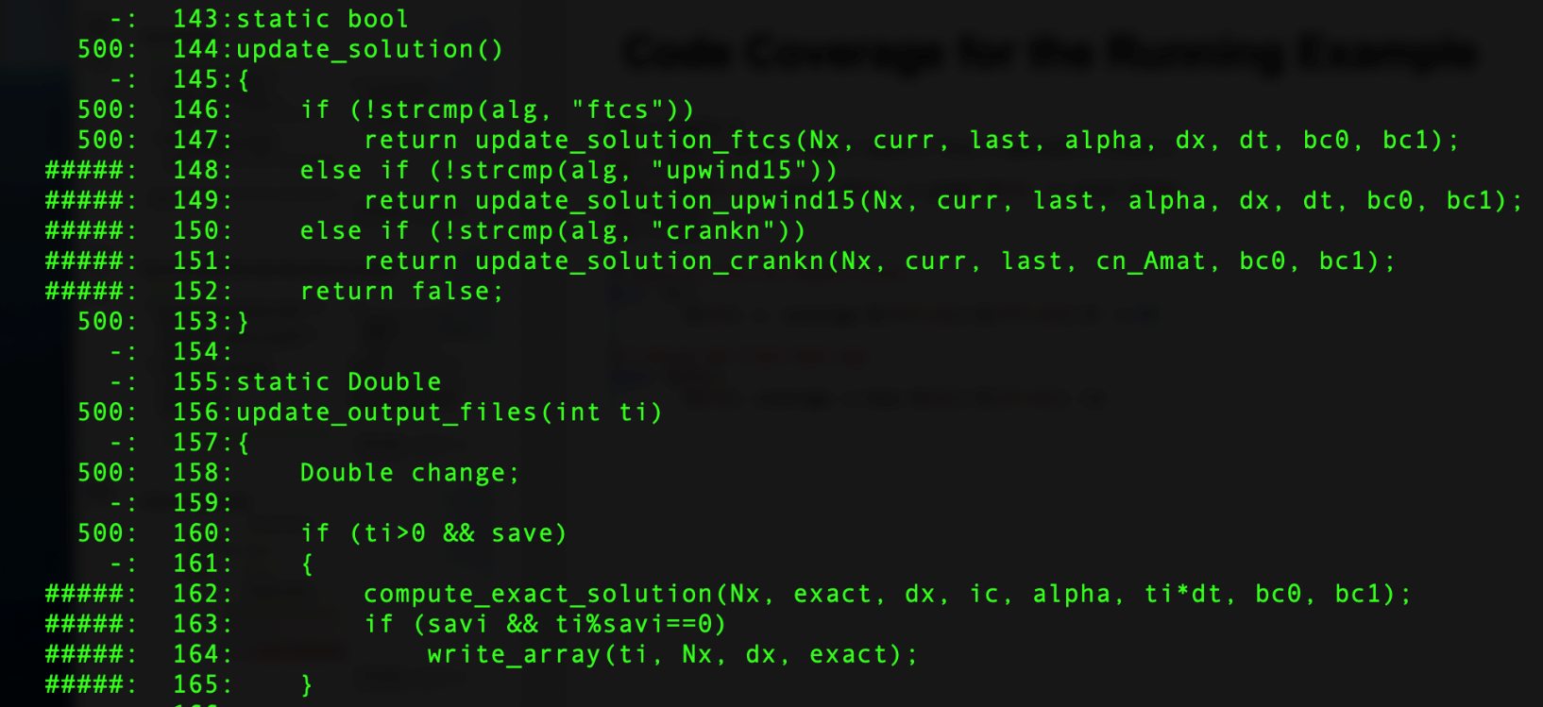
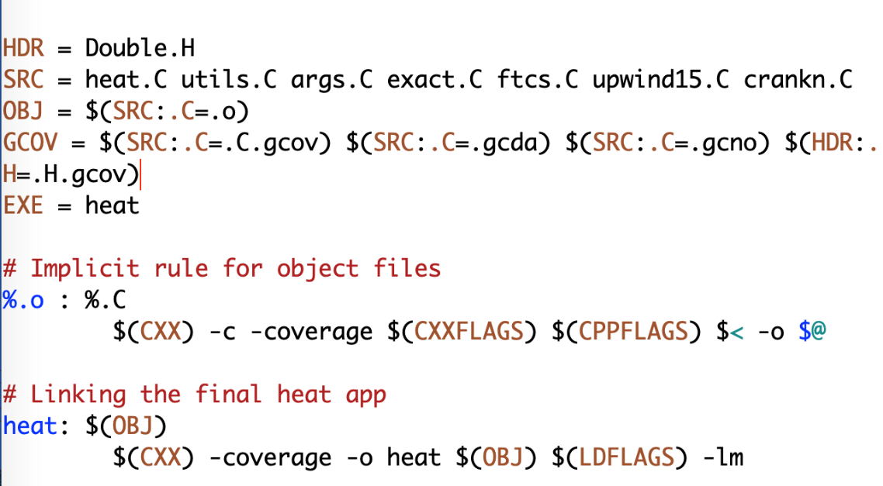
Checking coverage Example
Example of heat equation
Add -coverage as shown below to Makefile
Run ./heat runame=“ftcs_results”
Run gcov heat.C
Examine heat.C.gcov
A dash indicates non-executable line
A number indicated the times the line was called
##### indicates line wasn’t exercised

Slide 10
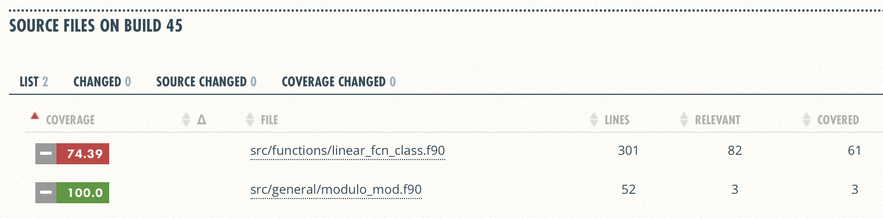
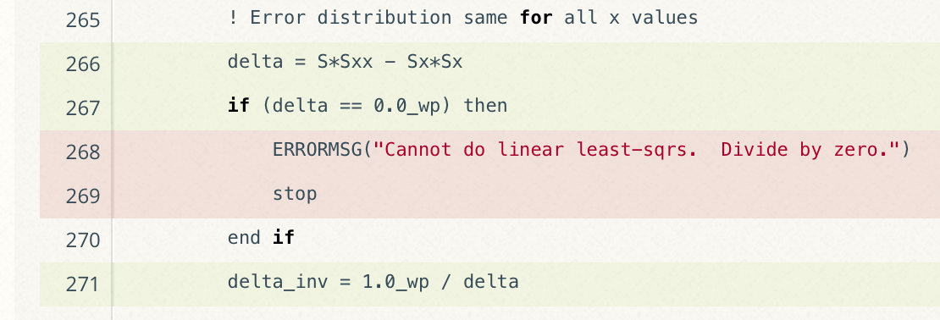
Graphical View of Gcov Output and Tutorials for Code Coverage
Overall Analysis
Detailed Analysis
Online tutorial - https://github.com/amklinv/morpheus
Other example - https://github.com/jrdoneal/infrastructure
Notes:
Here's an example of the graphical coverage summary you can get with hosted services. There's youtube tutorials for implementing these sorts of things.
Missing testing of edge cases. This might be important!

Slide 11
How to build your test suite ?
Two purposes
Regression testing
May be long running
Provide comprehensive coverage
Continuous integration
Quick diagnosis of error
A mix of different granularities works well
Unit tests for isolating component or sub-component level faults
Integration tests with simple to complex configuration and system level
Restart tests
Rules of thumb
Simple
Enable quick pin-pointing
Useful resources https://ideas-productivity.org/resources/howtos/

Slide 12
Test Development For a New Code
Development of tests and diagnostics goes hand-in-hand with code development
Non-trivial to devise good tests, but extremely important
Compare against simpler analytical or semi-analytical solutions
Build granularity into testing
Use scaffolding ideas to build confidence
Always inject errors to verify that the test is working
Detailed example in the next presentation

Slide 13
Test Development For a Legacy Code
There may not be existing tests
Isolate a small area of the code
Dump a useful state snapshot
Build a test driver
Start with only the files in the area
Link in dependencies
Copy if any customizations needed
Read in the state snapshot
Restart from the saved state
Verify correctness
Always inject errors to verify that the test is working
state
driver

Slide 14
Summary
A productive software team is always checking their work.
Take time to recognize these checks and harden them into “real,” repeatable tests.
Test layout should mirror the logical structure of your code.
Test each module, being aware of module to module dependencies.
Different challenges are associated with exploratory, legacy, and release codes.
Adapt your strategy to fit your situation.
Eventually you will want to be able to verify all components in a code release.
Don’t get distracted by all the technologies out there – focus on exercising your code.
Scaffolding projects can help with mechanics.

Slide 15
Agenda
Time (EDT) | Module | Topic | Speaker
2:30-2:35pm | 00 | Introduction | David E. Bernholdt, ORNL
2:35pm-2:40pm | 01 | Motivation and Overview | Patricia A. Grubel, LANL
2:40pm-3:00pm | 02 | Software Testing 1 | Patricia A. Grubel, LANL
3:00pm-3:25pm | 03 | Software Testing 2 | David E. Bernholdt, ORNL
3:25pm-3:55pm | 04 | Continuous Integration | James M. Willenbring, SNL
3:55pm-4:00pm | 05 | Summary | James M. Willenbring, SNL

